Slide 1
Transform Your Relationship with Your Business
(And Everything Else ☺)

Slide 2
You’re in the right place if…
You’ve been in business for at least 3 years and your business still consumes your life!

Slide 3
Perhaps…
You can’t sleep at night because you’re plagued by anxiety
You have revenues, yet there’s not much left over for you (time, money and/or energy)
Notes:
you can’t sleep at night without help because you have anxiety that everything that needs to isn’t getting done. You may not even be clear on what’s not getting done, you just feel as though you might be missing something.
You have good revenues, yet there’s not much left over for you (time, money and/or energy); at least not in the way you want to live
And the only thing that seems right is that you’re making money.

Slide 4
Or…
You’ve struggled to bring on the right people to help you grow
You feel like you’re in a small boat on a big ocean being tossed about by the wind and the waves
Notes:
And the only thing that seems right is that you’re making money.

Slide 5
Or Maybe…
You’ve lost your passion for and the confidence that you’re in the right business
Notes:
And the only thing that seems right is that you’re making money.

Slide 6
What would it take to transform your business so it can grow and make an impact while you get to live life your way?

Slide 7
It takes…
A clear understanding of who you are meant to be and how you’re designed to operate in the world
A powerful holistic vision
A blueprint, business model and strategy

Slide 8
Support to hold you to the path and navigate the challenges
Notes:
A blueprint, business model and strategy that bridges the gap between where you are and where you are going.
Support to hold you to the path and navigate the challenges as you take action to bring your vision to life.

Slide 9
Results
Things that used to stop you in your tracks, no longer do
You’re clear, confident and passionate about your direction and the decisions you are making

Slide 10
You feel supported by your business and excited about what’s possible
When the world outside goes wonky, you navigate nimbly with minimum negative impact

Slide 11
Ultimately, you’re living life your way and making a big difference in the world

Slide 12
This is NOT
A one-size-fits all approach
Productivity at the expense of Creativity
About you having to do business like everyone else

Slide 13
Nor is it…
About having to sacrifice other areas of your life to be successful and make an impact
About living a segmented life where you’re one way at work and another way in your personal life.

Slide 14
I work with Entrepreneurs who…
Want to scale and grow, yet their business has taken over their life
To Live Life their way while growing and expanding their impact in the world

Slide 15
That’s called a… Holistic Human Centered Approach to Business
Notes:
I work with entrepreneurs who want to scale and grow, yet their business has taken over their life, to live life their way while growing and expanding their impact in the world.

Slide 16
This program has 3 Phases

Slide 17
Discover
Discover your holistic vision and who you are meant to be as a leader

Slide 18
Design & Align
Design and align your business blueprint and life-map with your vision

Slide 19
Align, Implement & Evolve
Align, implement, and evolve the way work gets done with your company blueprint and vision

Slide 20
With my coaching, guidance, and proven framework you can…
Have a growing sustainable business that Lets you Live Life Your Way
And…
Make a difference in the world at the same time.

Slide 21
Here’s how it works…

Slide 22
Step #1
You need to discover your holistic vision and who you are meant to be as a leader

Slide 23
You need to know…
Where you are
How you’re showing up
The self-sabotage that gets in your way

Slide 24
You need to…
Acquire skills and tools to navigate your challenges

Slide 25
We’ll…
Cultivate and expand you as a leader

Slide 26
You’ll…
Discover that you are more than you think you are

Slide 27
As you…
Get to know and tangibly see who you are at the soul-level
Your purpose
How you’re designed to show up in the world

Slide 28
We’ll…
Work together to create a crystal-clear holistic vision to guide you forward

Slide 29
Deeply knowing you, how you are meant to show up in the world and having a crystal-clear holistic vision is your first step

Slide 30
Step #2
You need to design and align your business blueprint and life-map with your vision

Slide 31
You’ll…
Create an inspiring life map to guide you

Slide 32
We’ll…
Work together to design and develop a blueprint for your business

Slide 33
That includes creating
Your vision, mission, core values, purpose and strategic vision…

Slide 34
In a way that…
Inspires and engages you, your team and your clients/customers.

Slide 35
We’ll…
Work together to grow your leadership mindset

Slide 36
To be in alignment with and to the level necessary to bring your vision to life.

Slide 37
Creating a business blueprint and life-map that inspires you and clearly communicates your holistic vision and developing a mindset to match is your second step

Slide 38
Step #3
You need to align, implement, and evolve the way work gets done with your company blueprint and vision

Slide 39
You’ll…
Design your environment
Culture
Identify your dream team

Slide 40
You’ll…
Identify your core processes
Refine current product & services and/or delivery
Design additional offerings that leverage your expertise and genius

Slide 41
For where you are now
Position your business for further growth and expansion on all levels

Slide 42
I’ll…
Coach you
Hold the space for you to follow your vision when the going gets tuff
Be your guide and strongest advocate

Slide 43
To evolve your business and leadership as you align and implement the way work gets done with your company blueprint and vision is the third step

Slide 44
It’s Story Time ☺

Slide 45
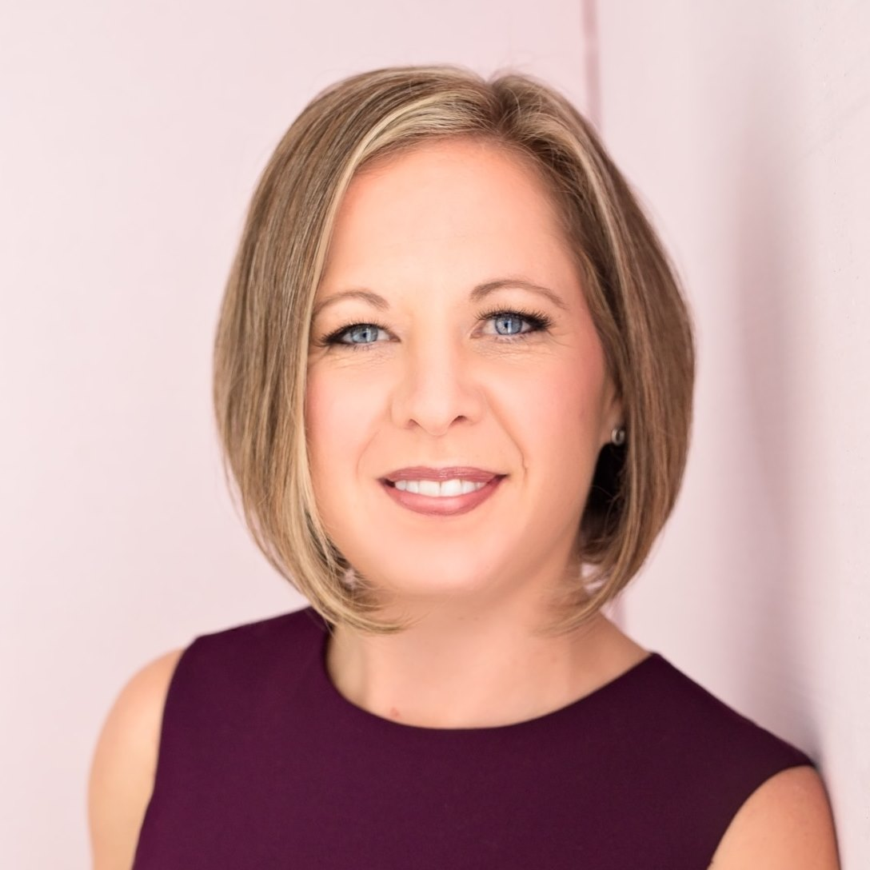
Meghann
Meghann went from low 5 figures to multiple 6 figures and found her soul mate

Slide 46
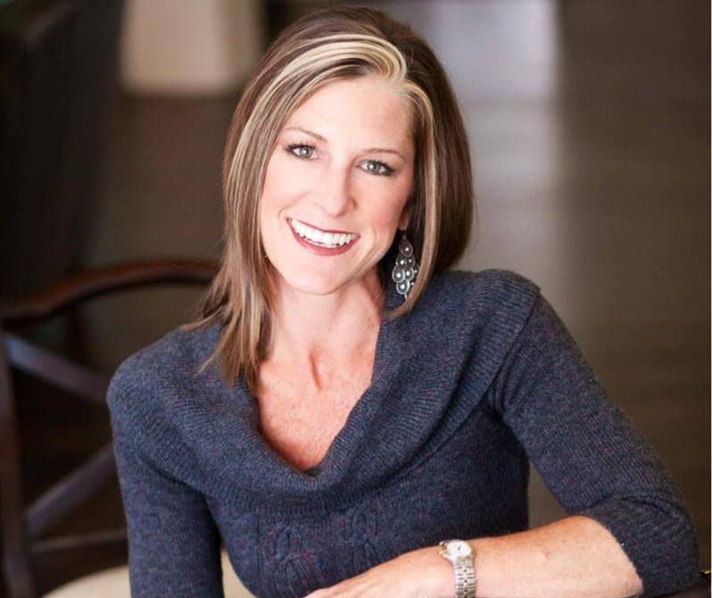
Sabrina
Sabrina received the clarity and tactics to grow big and sell while living life her way

Slide 47
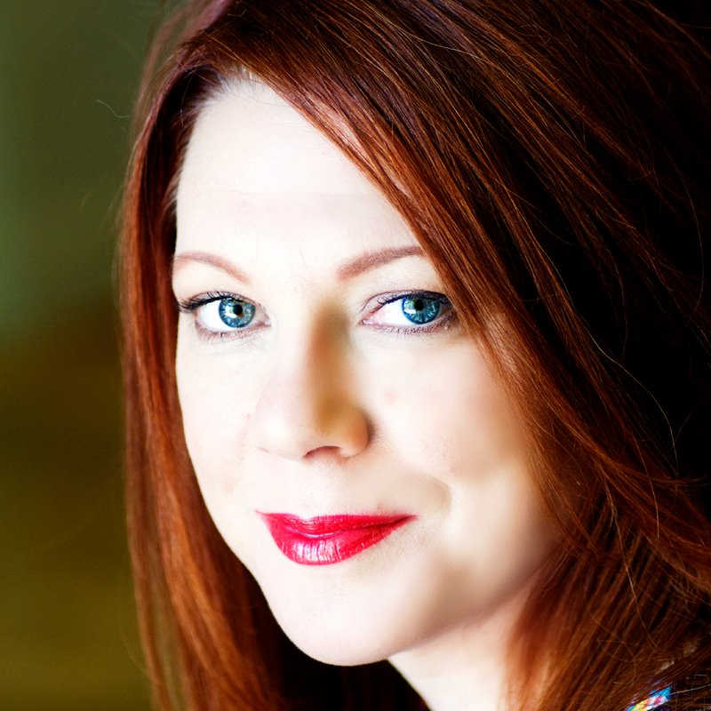
Victoria
Victoria discovered a completely new life and business aligned with her passions

Slide 48
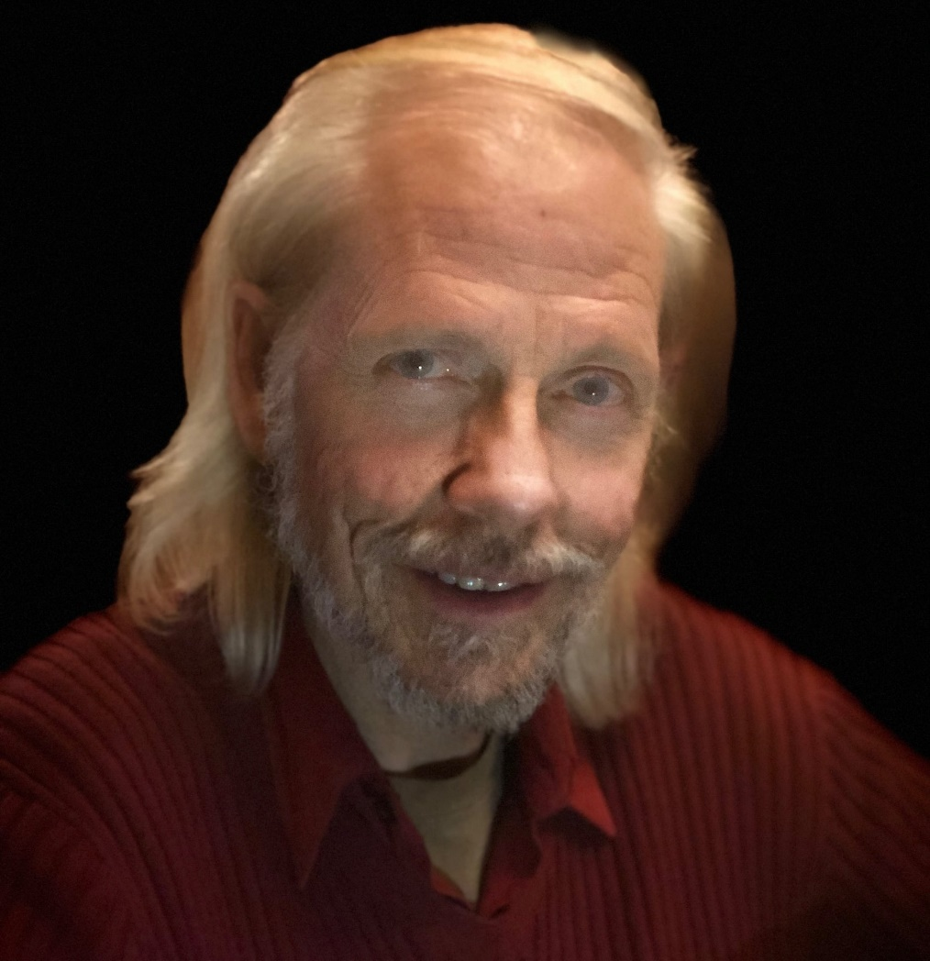
Gary
Gary was re-energized as he found clarity, focus and direction to get his business on track

Slide 49
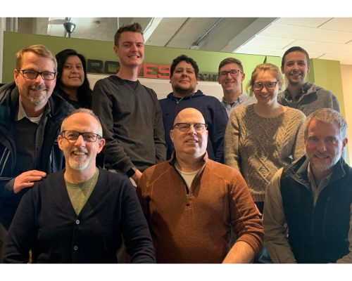
ArcWest Architects
ArcWest Architects went from a struggling collaborative of three with two contractors to a vibrant Architecture firm with employees and partners on the same page

Slide 50
Would you like to know how they achieved these results?

Slide 51
These entrepreneurs became…
Re-inspired
Passionate
Engaged with their path & business
To live life their way

Slide 52
Rise Up to BE the CEO you are Meant to BE!

Slide 53
We’ll work together to…

Slide 54
Discover…
Your holistic vision,
Who you are meant to be as a leader

Slide 55
Design and Develop
Your Life-Map
Business Blueprint

Slide 56
Align and Implement
Your vision in your business
Life!

Slide 57
When you’ve done all of these, you have a business that makes a difference in the world and supports you
To live life your way!

Slide 58
Ideal participants want to:
Grow their business to make an even greater impact/difference in the world
Grow who they are as a human and leader
Live Life Their Way!

Slide 59
Successful Participants…
Own that they create their reality
Willing to dive deep
Introspective
Committed to our work together

Slide 60
This program is a combination of…
Holistic Leadership Coaching
Mentoring
Consulting

Slide 61
The Primary Focus

Slide 62
Discover your holistic vision and who you are meant to be as a leader

Slide 63
Design and Align your business blueprint and life-map with your vision

Slide 64
Align and Implement your vision in your business

Slide 65
Program Structure

Slide 66
Program Structure
Kick-Off/Outcome Setting Session
Identify and dance with your dragons
Your Soul’s Expression Map
Two (2) One-on-one coaching sessions each month for 12 months

Slide 67
Agreed upon assignments to complete between calls
Life-Map and Business Blueprint Templates
1 – 2 Training Videos each month

Slide 68
Unlimited Emails & Text
Artifact (document) and process review
One VIP Ticket to the event “The Unlock Experience”

Slide 69
Kickoff/Outcome Setting Session
I get to know you and where you are
Your current perspectives
Specific outcomes you’d like to see

Slide 70
Includes:
1 – 2 Hours
Discovery Questionnaire
Holistic View Assessment
Preliminary Life Design Assessment

Slide 71
Kickoff Session Follow Up
We’ll begin the process to identify and dance with your dragons that have currently been in your way

Slide 72
One-0n-One Sessions
Discuss and navigate your challenges
Dance with your dragons
Brainstorm and develop your Life-map & Blueprint
Implement your vision

Slide 73
Includes:
Twice Monthly
Prep-Form
30 – 60 Minutes

Slide 74
Agreed Upon Assignments Including
Life-Map*
Blueprint*
* Templates Provided

Slide 75
1 – 2 Training Videos each month
Cognitive understanding
Alignment with where you are in the process
They will help guide you as you create your blueprint, life-map and more

Slide 76
Unlimited Emails & Text
I welcome your questions, celebrations, and requests for feedback

Slide 77
Artifact and Process Reviews
We’ll ensure that your Blueprint and any related processes you create are in alignment with you.

Slide 78
The Unlock Experience VIP Ticket
Enables you to participate and be part of a group to network and explore you in a different way

Slide 79
Why 12 months?

Slide 80
It Takes Time to…
Change and grow as a leader
Make the shifts in your business to align with your vision
Develop a sustainable foundation

Slide 81
What & Why is this work different?
I don’t just work with you on your business
I take a Holistic Human Centered Approach

Slide 82
I don’t give you a lot of information, good ideas and “To dos”.
I work hand-in-hand with you to go into action, the right action
Implement these ideas in your life and business.

Slide 83
Next Step…
Schedule a time to explore if this is a fit.
Victoria Lynne Hannu
victoria@heartandsoulceo.com

